Slide 1








Trolley Problem & AI
Module 3 – AI Governance, Ethics, Human Rights, and Democracy Teaching Unit 3 – AI Ethics & Moral Decision Making

Slide 2

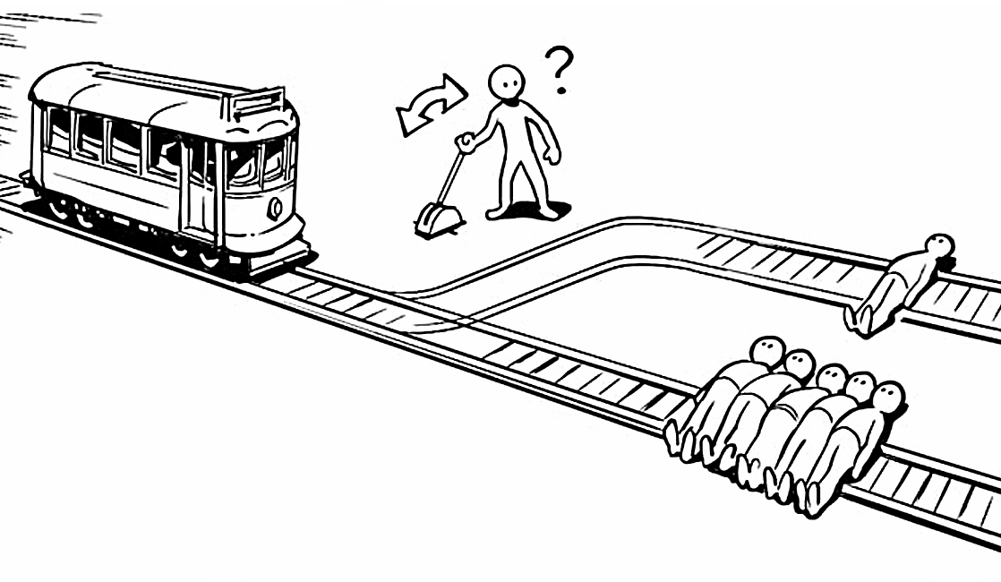

THE TROLLEY PROBLEM
Imagine you are standing next to a lever
(a switch that diverts trains). A train is travelling on the tracks.
On the track in front of the train are
five people who can't run away. If the train continues like this, they will be run over.
But you can flip the lever. Then the train will move onto another track. There is only one person on this track.
Now you have to make a decision:
  Do you do nothing? Then the five people will be run over.
  Do you pull the lever? Then one person will be run over, but the five others will live.
Photo: Hu, R. (2023)

Slide 3

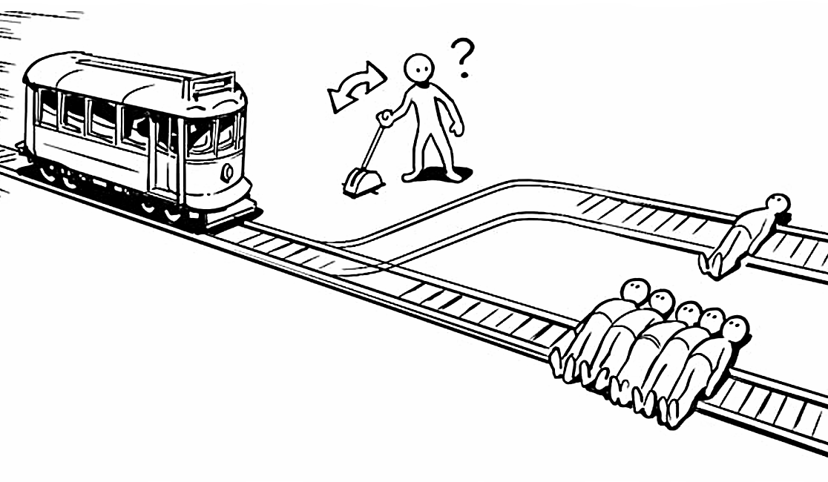


THE TROLLEY PROBLEM
So that's the trolley problem:
What is right? Sacrifice one person to save five?
Or do nothing and let five people die?
→ There is no simple answer – which is why many people are thinking about it.
But if the answer is so difficult for us humans, with an understanding of ethics and morality, how can a machine come up with the right answer?
Photo: Hu, R. (2023)

Slide 4
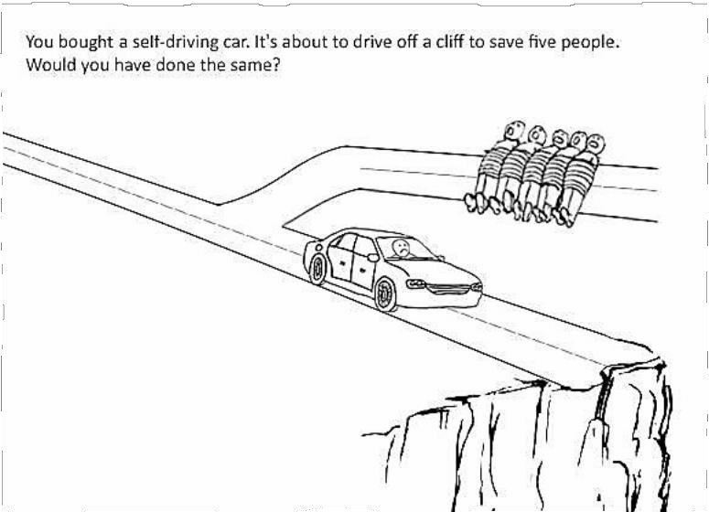
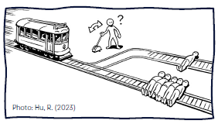
THE TROLLEY PROBLEM
Now imagine a self-driving car on the road.
→ Nobody is at the wheel - the car is driven by the computer alone.
Suddenly something happens:
→ Five people are on the road in front of the car, but car → cannot brake in time.
But:
→The car could swerve.
→If it swerves, it falls off a cliff - and the person in the car,
→the passenger, would die.
This raises a similar question to the trolley problem:
  Should the car save the five people and sacrifice the passenger to do so?
  Or should the car protect the passenger - and run over the five people?
3

Slide 5

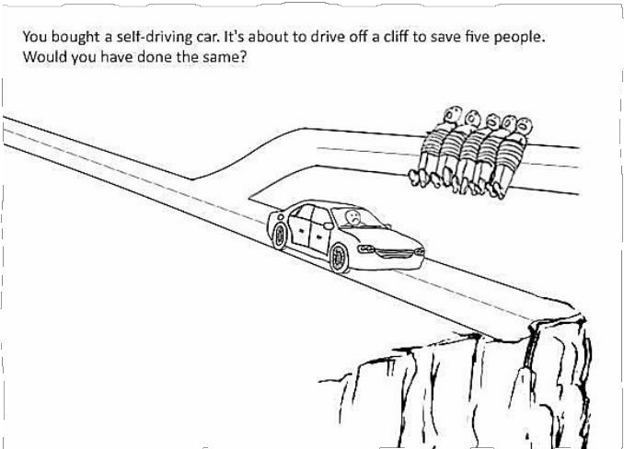

THE (MODERN) TROLLEY PROBLEM
But how does a machine decide what is right or wrong?
→ This is an ethical question - a question about morals and values.
If an accident happens - who should the car save?
  A young person or an old person?
  A pedestrian or the passenger?
Such questions are not technical, but human. This means that people have to give the AI rules according to which it should act.
Why is that important?
→ AI is becoming more and more a part of our lives - not only in cars, but also in medicine, governments, the police and at work.
That's why we need to think about it:
What is fair? Who is protected by technology - and who might not be? Who is responsible if something goes wrong?

Slide 6

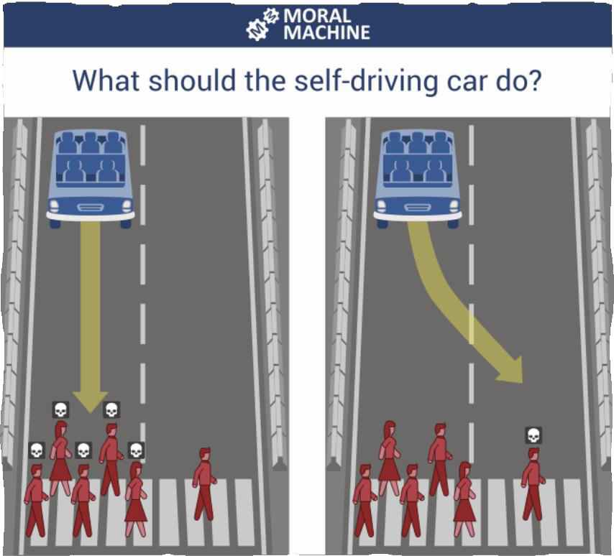


TRY FOR YOURSELF
If you want to see for yourself how such decisions can be made, there is an exciting website we are going to try: ‘Moral Machine’.
You will go through many situations like the trolley problem - but with self-driving cars.
You decide for yourself:
→ Who should the car save?
→ Who should it not?
You quickly realise how difficult
such decisions are
- and how differently people
think about them.
Photo: Moral Machine (2025)
5

Slide 7
PICTURE REFERENCES
  Hu, R. (2023): Trolley problem Picture. Retrieved April 16, 2025, from https://en.wikipedia.org/wiki/Trolley_problem
  MIT Media Lab (n.d.): Moral Machine. Retrieved April 16, 2025, from https://www.moralmachine.net/
  Trolley Problem Memes (2017): Should our self-driving cars follow a utilitarian approach? Retrieved April 16, 2025, from https://www.facebook.com/TrolleyProblemMemes/posts/should-our-self- driving-cars-follow-a-utilitarian-aproach-note-that-in-general- y/522355148113415/3
4

Slide 8


Thank you for your interest and attention.
Funded by the European Union. Views and opinions expressed are however those of the author(s) only and do not necessarily reflect those of the European Union or the European Education and Culture Executive Agency (EACEA). Neither the European Union nor EACEA can be held responsible for them.
Project No: KA220-VET-000165375
Copyright © 2026 by the partner consortium of the project “AI.D – Artificial Intelligence and the Shaping of Democracy”
This work is licensed under CC BY-SA 4.0

