Slide 1








AI in Digital Citizenship Education and Global Learning
Module 3 – AI Governance, Ethics, Human Rights, and Democracy Teaching Unit 2
Module 3 – AI Governance, Ethics, Human Rights, and Democracy Teaching Unit 2 – AI in Digital Citizenship Education and Global Learning

Slide 2

Content
BBC Quiz
Media Consumption
Group Discussion
Brainstorming
Social Development Goals (SDGs)
Research Task
Final Discussion

Slide 3
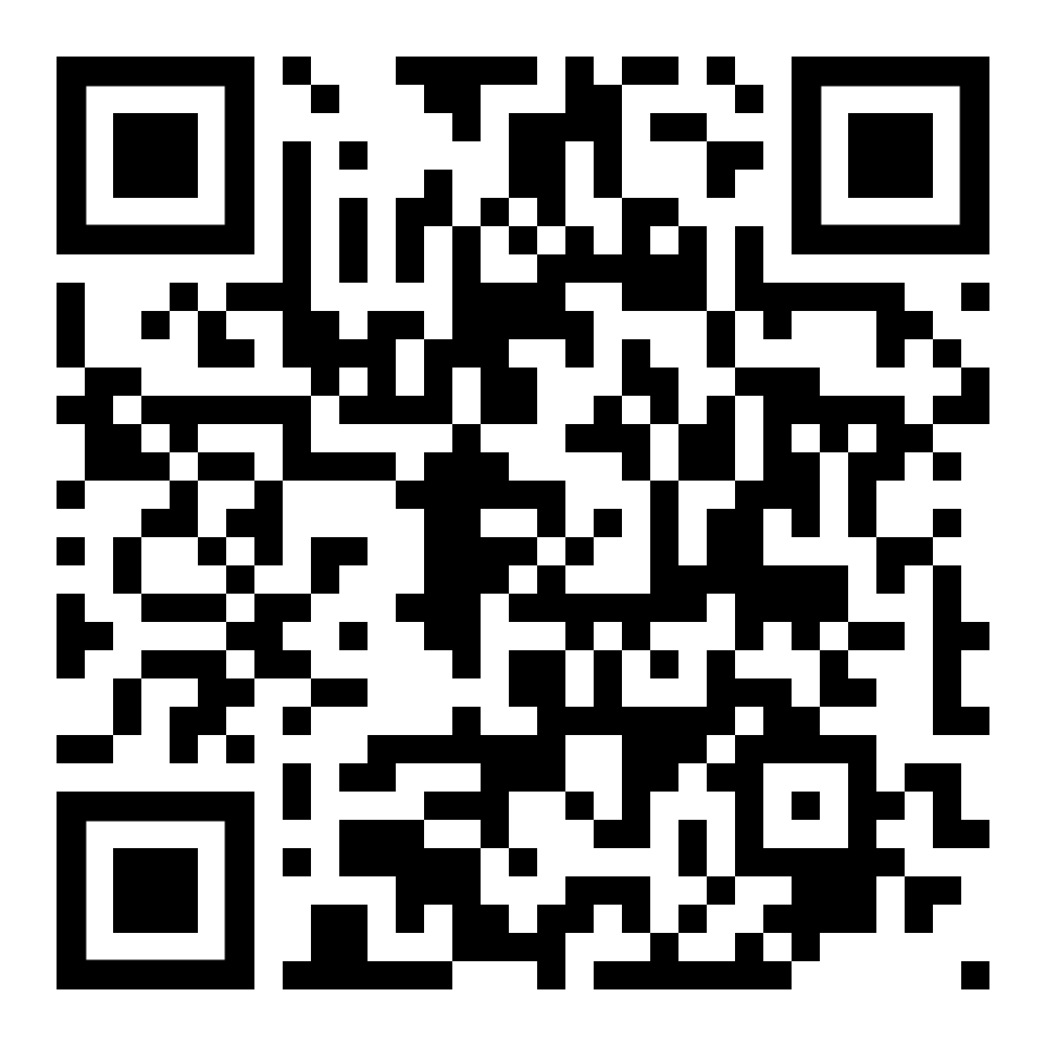

BBC Quiz
Procedure
(15 Min):
Test your knowledge and skills when it comes to detecting artificially generated content
Compare results and discuss what was easy and hard to detect
Scan the QR code to start with one of the BBC quiz series, “Artificial or Real?”

Slide 4
Media Consumption (5 Min)
Answer the following questions:
What media do you use to be informed about current events and politics? And for entertainment? Have you been able to detect AI-generated content in them?
How does your media consumption affect the way you form political opinions?

Slide 5
Group Discussion (25 Min)
Create 3-4 Groups. Each group gets one quote to discuss and present to the other groups afterwards.
Discuss how AI influences political judgment and decision-making, and why AI is important for an interdisciplinary approach to Digital Citizenship Education

Slide 6
Brainstorming
Procedure
(15 Min):
How does your subject relate to AI, digital literacy, or political awareness?
How can AI influence decision-making in your subject?
What role does critical thinking play in using AI responsibly?
Collect ideas on how the individual school subject can contribute to digital and political awareness concerning AI.

Slide 7
Sustainable Development Goals (SDGs)

Slide 8
Sustainable Development Goals (SDGs)
Set of 17 global objectives established by the United Nations in 2015, as part of the Agenda 2030
These goals aim to address global challenges for achieving peace, and justice, such as poverty, inequality, climate change, environmental degradation
The SDGs serve as a blueprint for a better future, encouraging governments, businesses, and individuals to take action towards a more sustainable and equitable world

Slide 9
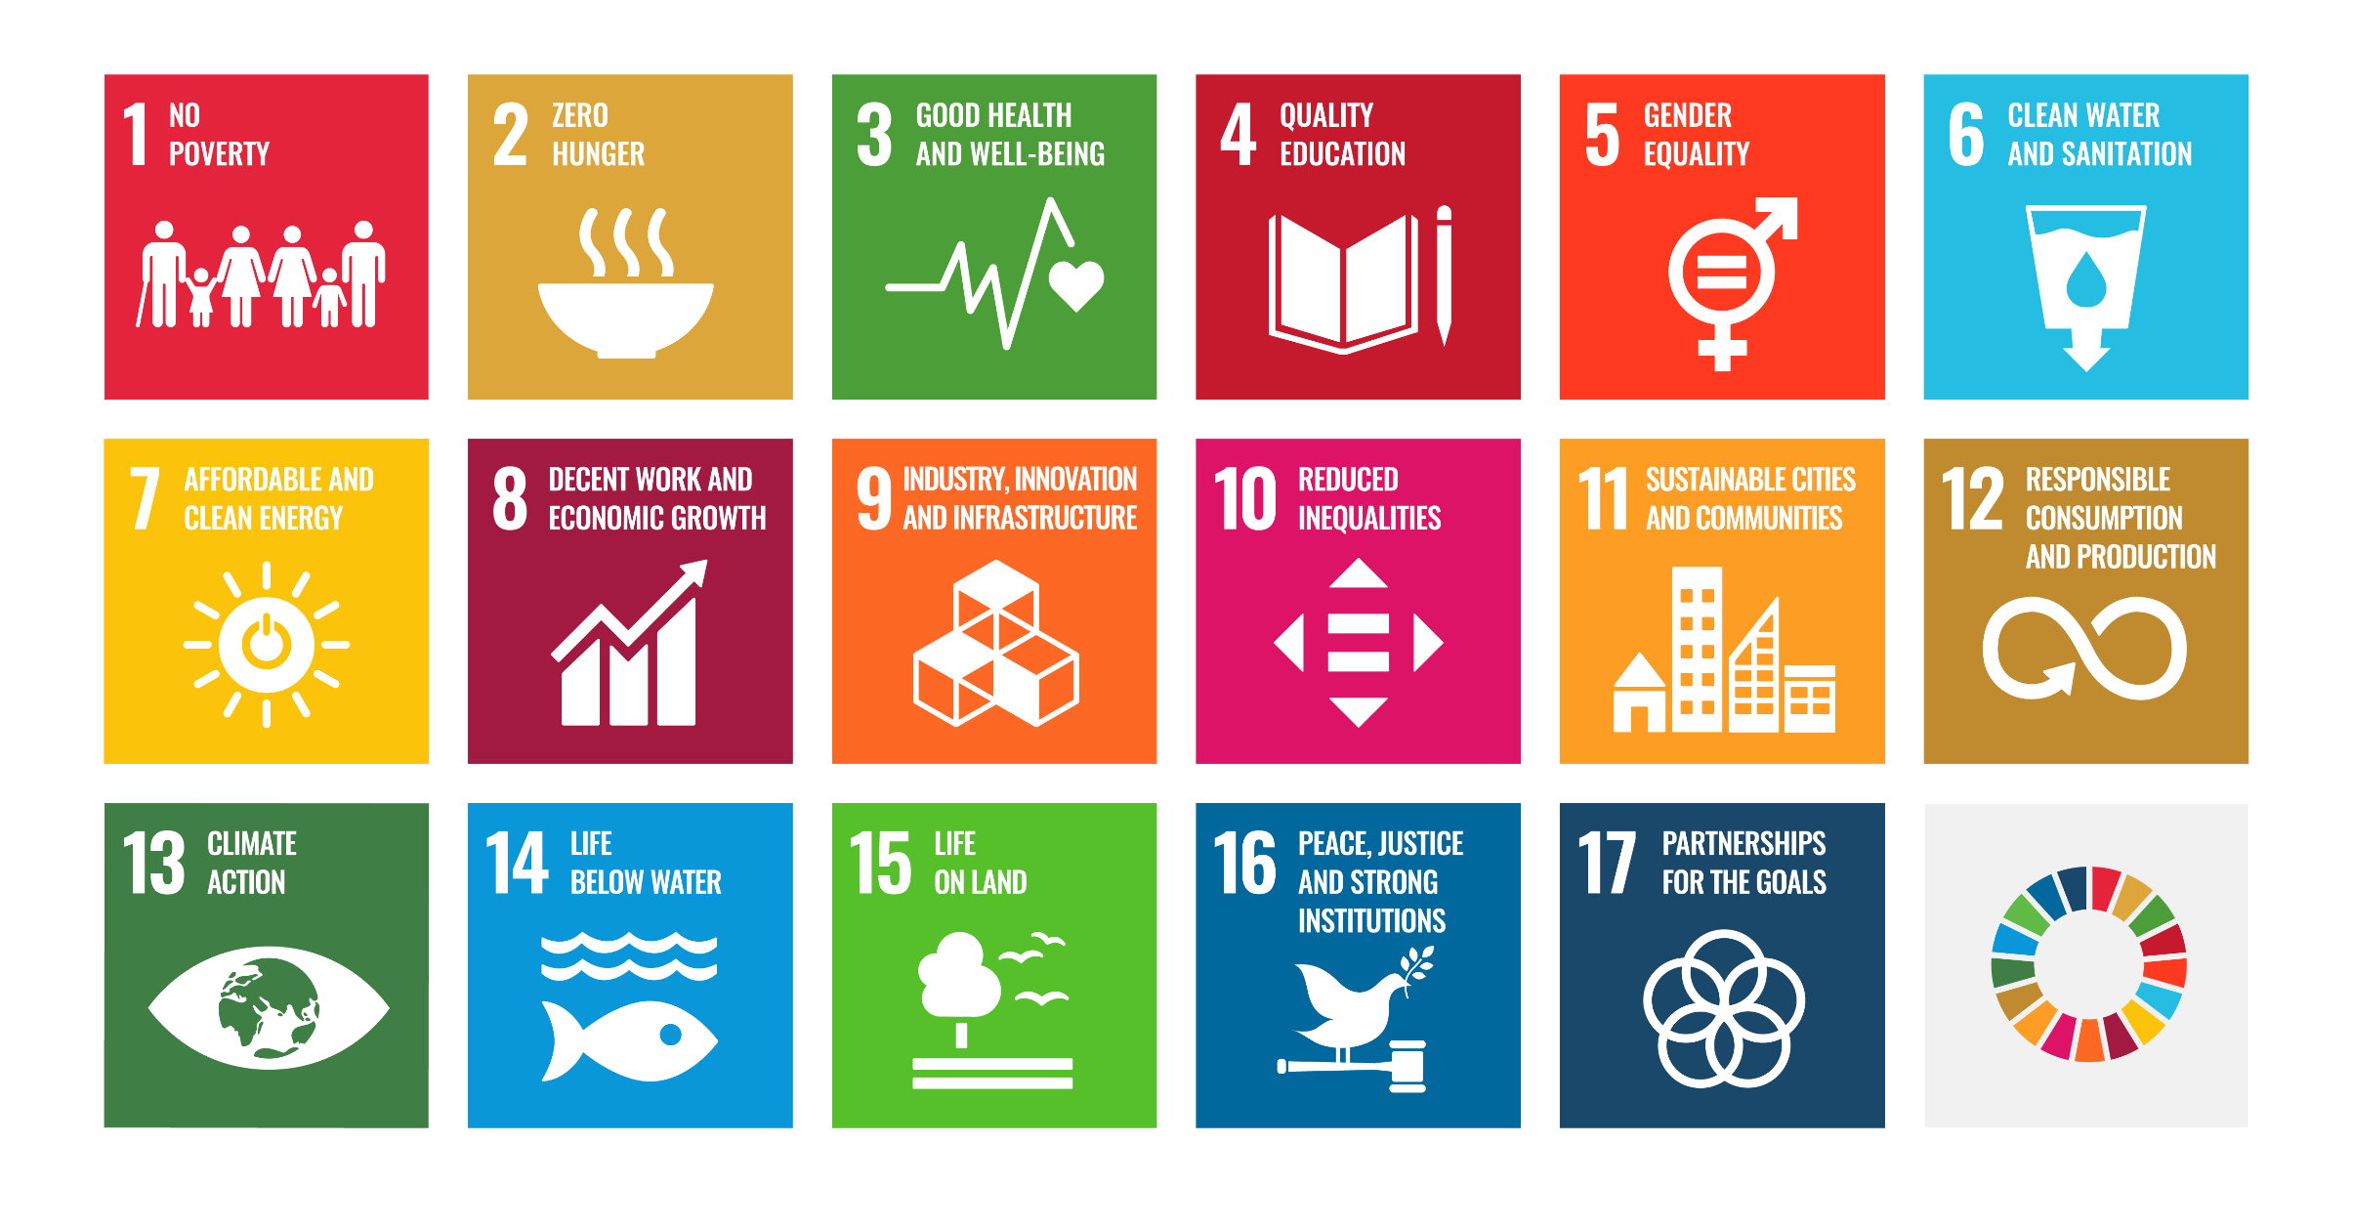
Image Source: https://www.un.org/sustainabledevelopment
The content of this publication has not been approved by the United Nations and does not reflect the views of the United Nations or its officials or Member States.

Slide 10

Task:
Brainstorm which SDGs might be particularly related to AI
Image Source: https://www.un.org/sustainabledevelopment
The content of this publication has not been approved by the United Nations and does not reflect the views of the United Nations or its officials or Member States.

Slide 11
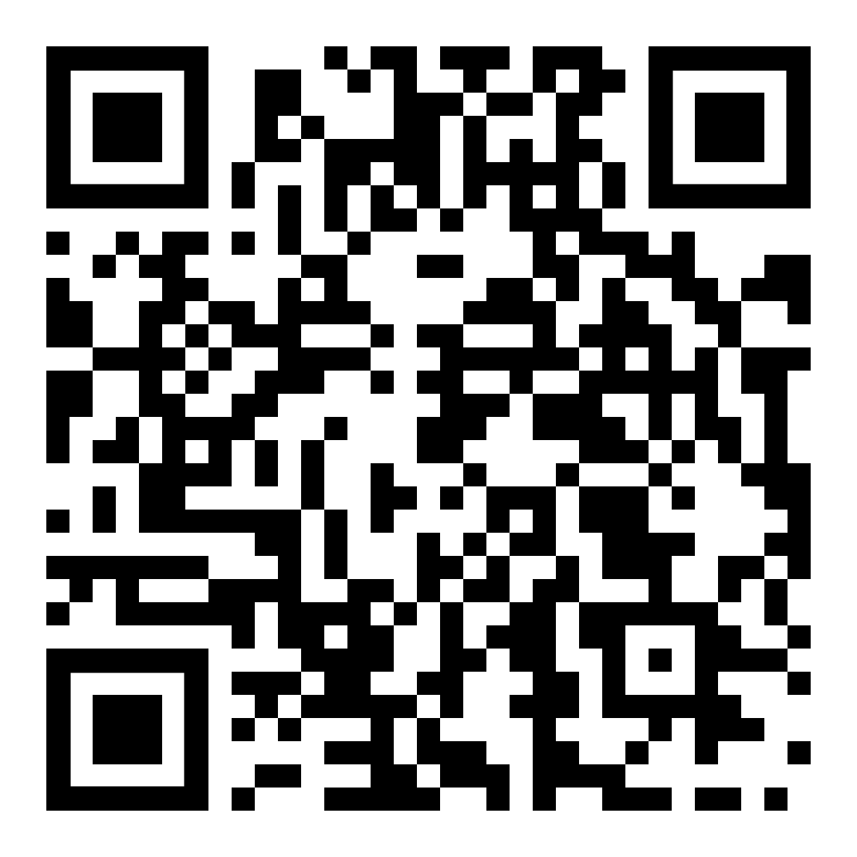

Research Task (15 Min)
Based on the results from brainstorming, participants are assigned to different SDGs in groups.
Use the SDG-AI-Explorer to research different publications (academic papers, news and magazine articles, short videos etc, available in German and English) relating to the specific SDG.
Find out how AI benefits and/or hinders reaching the respective goal.
After: Each group presents their results and explains the impact of AI on the respective SDG (15 Min).

Slide 12
Final Discussion (15 Min)
Start a group discussion on how AI affects global efforts for sustainability, democracy, and equality.
Impulse questions:
How does AI impact global politics?
Are there familiar/new global political dynamics because of it?
What is the role of the civil society in this discourse?

Slide 13


Thank you for your interest and attention.
Funded by the European Union. Views and opinions expressed are however those of the author(s) only and do not necessarily reflect those of the European Union or the European Education and Culture Executive Agency (EACEA). Neither the European Union nor EACEA can be held responsible for them.
Project No: KA220-VET-000165375
Copyright © 2026 by the partner consortium of the project “AI.D – Artificial Intelligence and the Shaping of Democracy”
This work is licensed under CC BY-SA 4.0

