Slide 1








AI Governance
Module 3 – AI Governance, Ethics, Human Rights, and Democracy Teaching Unit 1 – Local, Regional, National, and European:
AI Governance at a Glance

Slide 2

Content
Impulse
Definitions (+ Optional In-Depth Study)
Legislative AI Governance
Non-binding AI Governance
Research Task

Slide 3
IMPULSE
What do you understand by the term “Governance”?
Approach:
Quick answers, no right or wrong
Collect answers on the board, save for later

Slide 4
Definition
Digital Governance:
“Digital governance is the practice of establishing and implementing policies, procedures and standards for the proper development, use and management of the infosphere. It is also a matter of convention and good coordination, sometimes neither moral nor immoral, neither legal nor illegal” (Floridi, 2018, p. 3).
AI Governance:
“AI governance can be characterised as a variety of tools, solutions, and levers that influence AI development and applications” (Butcher & Beridze, 2019, p. 88).
Organizational AI Governance:
“AI governance is a system of rules, practices, processes, and technological tools that are employed to ensure an organization’s use of AI technologies aligns with the organization’s strategies, objectives, and values; fulfills legal requirements; and meets principles of ethical AI followed by the organization”
(Mäntymäki et al., 2022, p. 604).

Slide 5
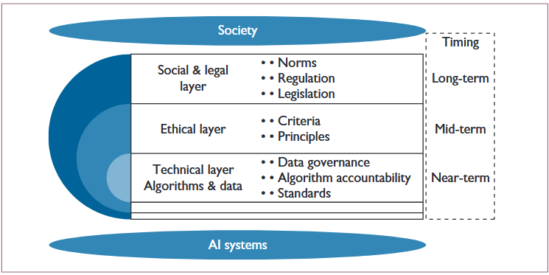
In-Depth Study: The Layered Model
Retrieved from: Gasser, U., & Almeida, V. A. F. (2017). A Layered Model for AI Governance. IEEE Internet Computing, 21(6), 58–62. IEEE Internet Computing. https://doi.org/10.1109/MIC.2017.4180835

Slide 6
Legislative AI Governance

Slide 7

EU AI Act – Brief Overview
regulatory framework by the EU with the goal to promote human-centric and trustworthy AI
aims to protect health, safety, fundamental rights, democracy, personal data, and environmental values
Gradual implementation of regulations by August 2026
The AI Act holds developers accountable for transparent and ethical development and deployment
AI

Slide 8
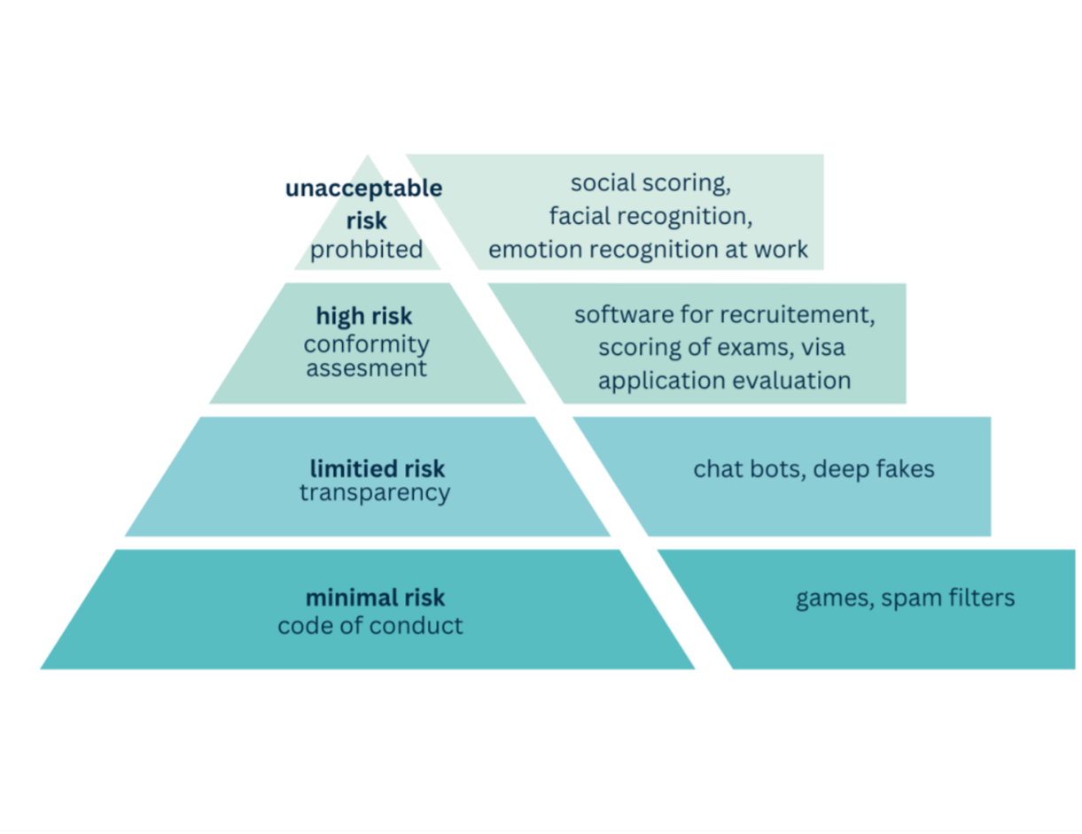
EU AI Act – Brief Overview
risk-based approach: AI systems with unacceptable risks are prohibited; high-risk applications have to pass a conformity assessment
National security-related activities are excluded from the scope
  Biometric recognition can potentially be implemented if used exclusively for national security
Unclear how laws will be enforced, EU bodies (e.g. European AI Office) and authorities of the Member States are both responsible
Visual re-elaborated based on: European Commission (n.d.) AI Act. https://digital-strategy.ec.europa.eu/en/policies/regulatory-framework-ai (Last retrieved on: February 26, 2025)

Slide 9
Non-binding AI Governance

Slide 10
Incomplete Overview
UN: “ Governing AI for Humanity”
acknowledges multiple societal risks of AI, calls for global governance, accountability, and transparency
identifies a significant gap between representation of Global North and South
AI governance in consideration of the SDGs
Recommendation 1: international scientific panel
Recommendation 2: policy dialogue on AI governance
Recommendation 3: AI standards exchange […]
Recommendation 6: global AI data framework
Recommendation 7: AI office within the UN Secretariat
EU: “Ethical Guidelines on the use of AI and data in teaching and learning”
specific examples and basic use-cases, underpinning ethical considerations and requirements
part of the EU Digital Education Action Plan and relating to DigComp 2.2 and DigCompEdu which define digital competences of teachers and citizens
empowers teachers to develop AI and data governance measures for their classroom collaborating with students

Slide 11
Incomplete Overview
Regional Example: “Guidelines from the North Rhine-Westphalia Ministry of Education”
focus on GenAI in the classroom
easily accessible basic technical knowledge about GenAI
legal framework conditions for use in a teaching context
practical tips to implement a responsible use of GenAI in the classroom
differentiation between technological, socio-cultural and application-related perspectives on GenAI
And many more:
Many sectors have developed industry-specific frameworks constumised to their specific needs and obstacles. Particularly in school education, national, regional, and local school authorities have developed specific governance approaches that educators must be familiar with.

Slide 12
Research Task
Procedure
(30 Min):
Gain an overview: What is new, what do you know already?
Are those strategies applied at your institution?
If so, are they efficient?
What is the main focus of the strategy?
Create your map of (regional and local) AI Governance initiatives for your specific setting (e.g. guidelines by regional or national government, local school authorities, etc.). You can, for example, use the OECD.AI-Database as a starting point.

Slide 13
Research Task
Create a map of AI Governance initiatives for your specific setting (e.g. guidelines by regional or national government, local school authorities, etc.)
Small Group Discussions (3-4 people, 10 Min.):
Which strategies do you consider effective and perhaps applicable to your context?
Differences and Similarities?

Slide 14
Sources
Butcher, J., & Beridze, I. (2019). What is the State of Artificial Intelligence Governance Globally? The RUSI Journal, 164(5–6), 88–96. https://doi.org/10.1080/03071847.2019.1694260
Floridi, L. (2018). Soft ethics, the governance of the digital and the General Data Protection Regulation. Philosophical Transactions of the Royal Society A: Mathematical, Physical and Engineering Sciences, 376(2133), 20180081. https://doi.org/10.1098/rsta.2018.0081
Gasser, U., & Almeida, V. A. F. (2017). A Layered Model for AI Governance. IEEE Internet Computing, 21(6), 58–62. IEEE Internet Computing. https://doi.org/10.1109/MIC.2017.4180835
Mäntymäki, M., Minkkinen, M., Birkstedt, T., & Viljanen, M. (2022). Defining organizational AI governance. AI and Ethics, 2(4), 603–609. https://doi.org/10.1007/s43681-022-00143-x

Slide 15


Thank you for your interest and attention.
Funded by the European Union. Views and opinions expressed are however those of the author(s) only and do not necessarily reflect those of the European Union or the European Education and Culture Executive Agency (EACEA). Neither the European Union nor EACEA can be held responsible for them.
Project No: KA220-VET-000165375
Copyright © 2026 by the partner consortium of the project “AI.D – Artificial Intelligence and the Shaping of Democracy”
This work is licensed under CC BY-SA 4.0

