Slide 1








GenAI Images
Module 2 – Systemic Implications of AI
Teaching Unit 1 – GenAI Images

Slide 2

Content
Understanding Gen AI Images
1.1 Understanding images in social media trends
1.2 Exercise: Analysing #aiart #aiartwork
Biases in GenAI images
2.1 The problem with GenAI images: Biases.
2.2 GenAI images on social media
2.3 Effects on society

Slide 3
Understanding Gen AI Images

Slide 4
Understanding images in social media trends
Images:
… shape the way we see the world.
… are embedded in the societal and historical context of the time they were created.
Iconography:
… is a method to interpret visual content developed by Erwin Panofsky (1978). It has 3 steps: describe – analyse – interpret images.
… can be used as a tool to understand images.

Slide 5
EXERCISE
Approach:
Scan the QR-Code on the next slide or use the social media app of your choice and search for #aiart or #aiartworketrieved. Please choose one image
You will be presented with 2 slides with images retrieved from Instagram. Please choose one image.
Optional: If you are doing the exercise in a group and have an account on social media such as Instagram/TikTok/Facebook/etc., you can alternatively choose an image you find on social media under the hashtag #aiart or #aiartwork. This requires that at least one more learner also chooses an image from their hashtag-search results on social media. (It allows you to further consider the ways in which the different personalised algorithms might impact your search results. For further reflection see "Optional: Context Analysis" on slide 12.)
After you choose it, in the following slides you will be given a set of questions to describe, analyse and interpret that image. Please answer only the questions that apply to the image you selected.
Analysing #aiart #aiartwork
Optional: If you are doing the exercise in a group and have an account on social media such as Instagram/TikTok/Facebook/etc., you can alternatively choose an image you find on social media under the hashtag #aiart or #aiartwork. This requires that at least one more learner also chooses an image from their hashtag-search results on social media. (It allows you to further consider the ways in which the different personalised algorithms might impact your search results. For further reflection see "Optional: Context Analysis" on slide 12.)
After you choose it, in the following slides you will be given a set of questions to describe, analyse and interpret that image. Please answer only the questions that apply to the image you selected

Slide 6
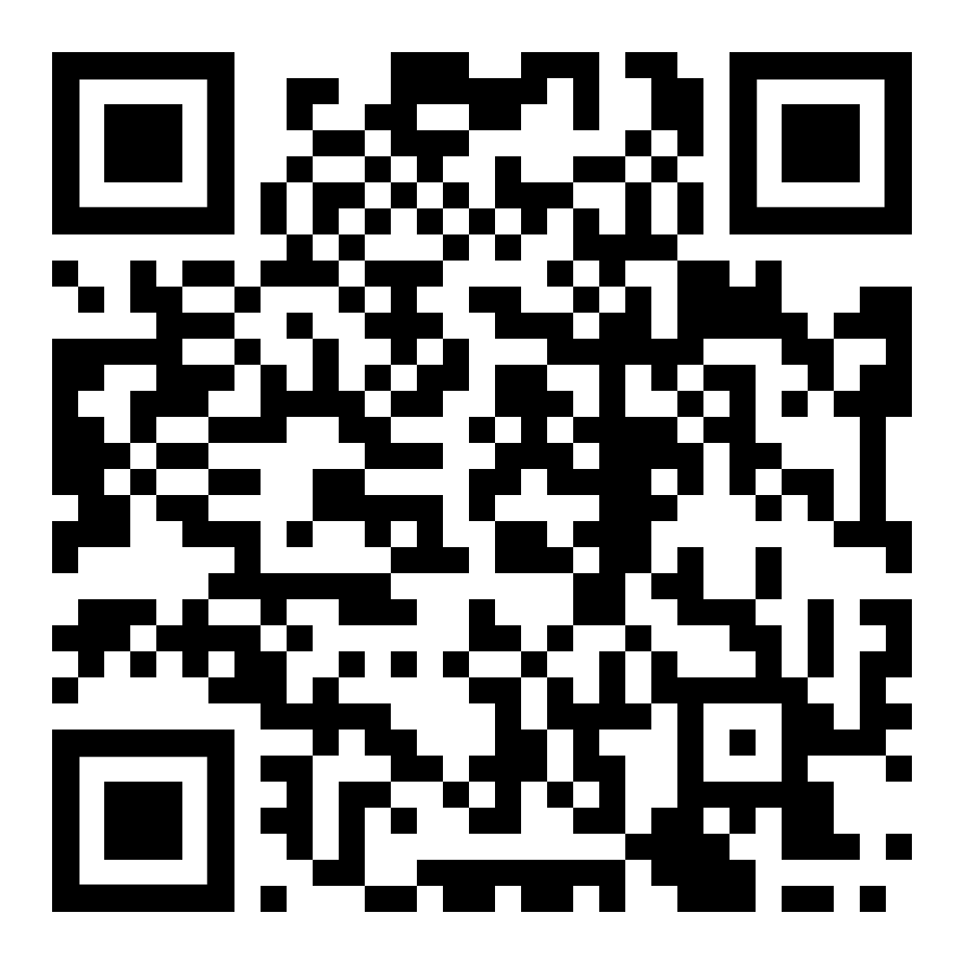
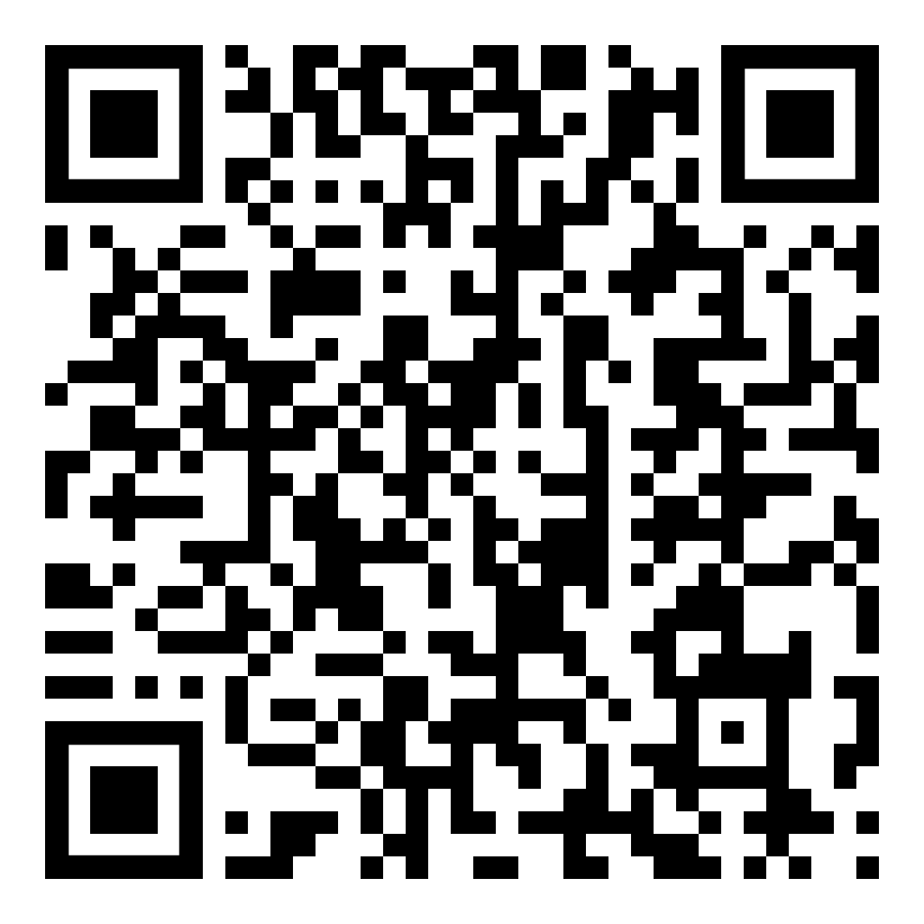
Scan for Instagram search: #aiart
Scan for Instagram search: #aiartwork

Slide 7
EXERCISE 1
Approach:
Choose one image from the search results for #aiart or #aiartwork in the social media app of your choice. Describe it by answering the following questions:
  What elements can you see in the image? Please describe them without connotations: e.g. "in the image there is a woman and a tree" instead of saying "in the image there is a blonde woman and a tree with green leaves".
  What is depicted in the foreground/background? And in the centre?
  Are there people in the image? What are they doing? What are their physical features?
  Are there things in the image? What is their function?
  Are there symbols in the image?
Image Description
Questions self-translated and adapted from Mayrhofer, n.d retrieved on 1 April 2025 from
https://demokratiezentrum.org/wp-content/uploads/2021/05/guideline_bildanalyse.pdf

Slide 8
EXERCISE 2
Approach:
Analyse the image by answering these questions:
  How are people/the person/the things/the landscape depicted? (realistic, mocking, negative, positive, friendly, scary...)
  Does the image set a specific tone? (joyful, dramatic, fearful …)
  Is there something that seems irritating/odd to you?
  If there are symbols/specific features of people shown in the image, what do they stand for?
Image Analysis
Questions self-translated and adapted from Mayrhofer, n.d retrieved on 1 April 2025 from​
https://demokratiezentrum.org/wp-content/uploads/2021/05/guideline_bildanalyse.pdf

Slide 9
EXERCISE 3a
Approach:
Reflecting on how people and situations are portrayed can help us understand how society's biases are depicted in images. Think of diversity and then answer these questions:
  How are people positioned?
  If there is more than one person/object in the photo, who or what is taking up the most space? Who is positioned in the foreground/background? Are they positioned on the same level or is there a (metaphorical) hierarchy?
  If there are people, what are they doing? Who is passive and who is active?
  How is body language depicted? Who is making themselves seem small? Who looks confident?
Image Interpretation –
Diversity
Questions self-translated and adapted from Scheer (2019). Retrieved on 01 April 2025 from
https://static.uni-graz.at/fileadmin/Akgl/4_Fuer_MitarbeiterInnen
/Diversitaetssensible_Bildgestaltung_mit_Beispielfotos.pdf
Notes:
https://static.uni-graz.at/fileadmin/Akgl/4_Fuer_MitarbeiterInnen/Diversitaetssensible_Bildgestaltung_mit_Beispielfotos.pdf

Slide 10
EXERCISE 3b
Approach:
Reflecting on how people and situations are portrayed can help us understand how society's biases are depicted in images. Think of diversity and then answer these questions:
  What are people's clothing supposed to tell us about the job/social class of a person? Who is depicted in which clothes?
  Are there recurring symbols/features in multiple images? What could they stand for?
  What kind of "norms" are depicted (heteronormativity, gender roles, bodyweight, (dis)abilities...)?
  What norms are broken?
Image Interpretation –
Diversity
Questions self-translated and adapted from Scheer (2019). Retrieved on 01 April 2025 from
https://static.uni-graz.at/fileadmin/Akgl/4_Fuer_MitarbeiterInnen/Diversitaetssensible_
Bildgestaltung_mit_Beispielfotos.pdf

Slide 11
EXERCISE 4
Optional
Approach:
If you have chosen an image from the hashtag-search-results on your own social media app, please go back into the search results and compare them with the results of another learner in your group. Together, respond to these questions:
  How do the accounts, perspectives, or types of content appearing most frequently differ between your search results and your partner’s?
  What prior interactions (likes, follows, searches, location, engagement style) might have shaped the algorithm to show you these results? Can you identify any patterns based on your own social media habits?
  How might your demographic attributes (age, location, gender, interests), or past content engagement have contributed to differences in the content surfaced for each of you?
  How does seeing the differences in your hashtag results impact your trust in algorithmically delivered content and your perception of the social world?
Context Analysis

Slide 12
Biases in GenAI Images

Slide 13
The Problem with GenAI Images: Biases
(Shukla, 2025)
Images generated by AI circulating on social media are often biased because of two main reasons:
Biased training data: The generative AI (GenAI) is trained with systematically skewed data.
Algorithmic bias: The GenAI's algorithm is impacted by the motivation and the level of awareness of the software engineers.
Notes:
What Is Algorithmic Bias? | IBM

Slide 14
The Problem with GenAI Images: Biases
(Shukla, 2025; Trewin, 2018; Whittakre, 2019)
a) Biased training data: How can data be biased?
Example
AI datasets risk misrepresenting disability because they rely on fixed categories, while disability is fluid, diverse, and often invisible, especially when there is not enough data (Trewin, 2018). Simply adding more labels fails to ensure fair representation and highlights broader issues with how AI rigidly classifies human diversity
(Whittakre, 2019).
Data is not as objective as many might think
"subjectivity, context, collection, categorization practices and storage" (Shukla, 2025, p. 3) of data reflect current societal realities and inequalities
This means that certain (underlying) motivations and thus biases are reflected in
  how the data was collected.
  what kind of data was collected.
  what kind of data was not collected.
  how the collected data is categorized
  and whether the data is stored for future use
Notes:
What Is Algorithmic Bias? | IBM

Slide 15
The Problem with GenAI Images: Biases
(Bucher, 2018)
b) Algorithmic bias: Background
What are algorithms?
Algorithms are detailed step-by-step instructions developed by software engineers for evaluating and categorizing data with a specific goal or output in mind.
Traditional algorithms are completely written by software engineers and are not considered AI.
Machine learning algorithms (aka AI)
… are constantly in the process of development.
… are trained on large datasets to learn the rules of the data's patterns in this constant development.
… are often trained in a semi-supervised manner, meaning that the data set is partially categorized and partially raw, including some desired outputs.
… are able to find unforeseen patterns and suitable outcomes on its own, next to the categories and goals provided by the software engineers.
Notes:
What Is Algorithmic Bias? | IBM

Slide 16
GenAI Images on Social Media:
(Bucher, 2018; Whittakre, 2019)
b) Algorithmic bias: How can algorithms of GenAI be biased?
"…algorithms need to be understood as powerful gatekeepers, playing an important role in deciding who gets to be seen and heard and whose voices are considered less important." (Bucher, 2018, p. 7-8)
All kinds of decisions go into building the algorithm
How biased an algorithm is depends on who makes these decisions and how aware of human diversity and other important topics they are (Bucher, 2018).
Structural discrimination shapes access to software engineering and critical AI literacy.
Those access patterns affect who builds, critiques, and governs AI and whose lived realities are reflected in the categories and desired outputs, identified and pursued by the algorithm (Whittakre, 2019)
Which kinds of decisions does the algorithm make independently?
Depending on how biased the training data and the supervision of the developers are, machine learning algorithms may detect this bias as a relevant pattern and reflect it in its outcomes.
Notes:
What Is Algorithmic Bias? | IBM

Slide 17
GenAI Images on Social Media:
The "For-You-Page" and Algorithmic Bias
Social media
We usually come in contact with GenAI images via social media.
What we see on social media is heavily influenced by algorithms that identify what engages us, keeps us online, and thus maximizes profit for the social media company.
Algorithmic bias on the "For-You-Page":
Most large social media companies use machine learning algorithms to determine which content users engage with.
We encounter algorithmic bias both in the creation of GenAI images and in their distribution on social media via machine learning algorithms.
Notes:
What Is Algorithmic Bias? | IBM

Slide 18
GenAI Images on Social Media:
The "For-You-Page" and Algorithmic Bias
Algorithmic bias creates user bias:
AI algorithms on social media curate highly personalised content for each user.
This creates "comfort zones" that discourage confrontation with diverse opinions, fostering political polarisation and risk of radicalisation (Rodilosse, 2024; Sharma et al. 2024 ).
Engagement-based ranking systems prioritise sensationalist and borderline content for higher engagement rates (Institute for Strategic Dialogue, 2025).
Machine learning algorithms amplify extremist content, including hate speech and misinformation (O’Connor & Holt, 2024; Matlach & Hammer, 2024)
Extremist content creators exploit algorithms to increase the visibility of extremist content (Institute for Strategic Dialogue, 2022)
  GenAI allow the far right to quickly generate massive amounts of content to “flood the zone with shit” (Rau et al., 2025).
The TikTok algorithm has been found to promote and amplify white supremacist content. (O'Connor & Holt, 2024)
YouTube's algorithms have been found to disproportionately suggest misogynistic and extremist content. (Thomas & Balint, 2022)
Notes:
What Is Algorithmic Bias? | IBM

Slide 19
Effects on society
(Bass & Nicoletti, 2023; Merino et al., 2024; UCL, 2024)
Biased society
Biased AI outcomes
Reenforcing biases in AI users
AI is seen as "neutral" therefore users deny that it can be biased
AI may normalise discriminatory behaviours
Misrepresentation or lack of representation in GenAI images leading to diminished feeling of belonging/alter own expectations e.g.
  Women of color depicted only in low-paying jobs
  Men of color depicted as criminals
Overall effect of social media and beauty standards on self-worth
AI algorithms promote polarisation and radicalisation, compromising users' democratic deliberation and critical thinking skills

Slide 20
Effects on society
Real-life examples
Source | Biased training data
Result | Data about structurally discriminated groups of people are not/less often collected, not/less often stored or not/ less often analysed
Real-World-Example | An AI generated picture of a group of people often consists of only young, able-bodied women and men, because the majority of the photos of groups of people in the training data does not show non-binary, elderly or disabled people.
Example 1
Notes:
What Is Algorithmic Bias? | IBM

Slide 21
Effects on society
Real-life examples
Source | Algorithmic bias
Result | Existing data are misinterpreted and/or outputs are skewed because of blind spots in the engineering process and/or certain algorithmic goals provided by software engineers or identified independently by semi-supervised algorithms.
Real-World-Example | On a social media platform, the recommendation system boosts AI-generated images of highly sexualized women under #aiart because it ranks posts by engagement and past user behaviour shows that these images receive more clicks and watch time. This means more ad-revenue which is a priority of the social media company. Over time, this feedback loop teaches both the algorithm and many creators that “successful” AI art means producing sexualized images of women, crowding out other subjects and styles and normalizing sexist visual norms.
Example 2
Notes:
What Is Algorithmic Bias? | IBM

Slide 22
Effects on society
Real-life examples
Source | Algorithmic bias and biased training data
Result | Software engineer bias/blind spots and lack of access for structurally discriminated groups to development teams The training data's categorisation is insufficient and thus misrepresents reality The training data did not contain enough information about discriminated groups
Real-World-Example | A text-to-image generator repeatedly adds prosthetic limbs or “fixes” facial differences when disabled users try to create images that reflect their own bodies, because the design team never involved disabled people in defining what accurate, non-stereotypical representation should look like. The system treats non-disabled bodies as the default and “corrects” anything that deviates from that norm.
Example 3
Notes:
What Is Algorithmic Bias? | IBM

Slide 23
Sources
American Psychological Association. (2018a). Bias. APA Dictionary of Psychology. Retrieved March 20, 2025, from https://dictionary.apa.org/bias
American Psychological Association. (2018b). Stereotype. APA Dictionary of Psychology. Retrieved March 20, 2025, from https://dictionary.apa.org/stereotype
Bass, D., & Nicoletti, L. (2023, June 9). Humans Are Biased. Generative AI Is Even Worse. Bloomberg. Retrieved March 18, 2025, from https://www.bloomberg.com/graphics/2023-generative-ai-bias/
Federal Office for Information Security. (n.d.). Deep Fakes – Threats and Countermeasures. Retrieved March 20, 2025, from https://www.bsi.bund.de/EN/Themen/Unternehmen-und-Organisationen/Informationen-und-Empfehlungen/Kuenstliche-Intelligenz/Deepfakes/deepfakes.html?nn=1011618
Institute of Strategic Dialogue. (2022, October 13). How platforms’ systems contributed to the rise of manosphere influencer Andrew Tate. Institute for Strategic Dialogue. Retrieved March 31, 2025, from https://www.isdglobal.org/isd-in-the-news/how-platforms-systems-contributed-to-the-rise-of-manosphere-influence-andrew-tate/
Institute for Strategic Dialogue. (2025). ISD Written evidence to the Science, Innovation and Technology Committee inquiry on social media, misinformation and harmful algorithms. Institute for Strategic Dialogue. Retrieved March 31, 2025, from https://www.isdglobal.org/wp-content/uploads/2025/01/ISD-Written-Evidence-to-the-Science-Innovation-and-Technology-Committee-Inquiry-on-Social-Media-Misinformation-and-Harmful-Algorithms.pdf
Jonker, A., & Rogers, J. (2024, September 20). What Is Algorithmic Bias? IBM. Retrieved March 18, 2025, from https://www.ibm.com/think/topics/algorithmic-bias
Marr, B. (2023, August 8). Is Generative AI Stealing From Artists? Forbes. Retrieved March 18, 2025, from https://www.forbes.com/sites/bernardmarr/2023/08/08/is-generative-ai-stealing-from-artists/
Mayrhofer, P. (n.d.). Guideline zur Bildanalyse im Unterricht. Demokratiezentrum Wien. Retrieved March 18, 2025, from https://demokratiezentrum.org/wp-content/uploads/2021/05/guideline_bildanalyse.pdf
Matlach, P., & Hammer, D. (2024). The German Far Right online: A longitudinal study (Huberta von Voss, Ed.). Retrieved on March 31, 2025, from https://www.isdglobal.org/wp-content/uploads/2024/01/the-german-far-right-online-a-longitudinal-study1.pdf
Merino, M., Tornero-Aguilera, J. F., Rubio-Zarapuz, A., Villanueva-Tobaldo, C. V., Martín-Rodríguez, A., & Clemente-Suárez, V. J. (2024). Body Perceptions and Psychological Well-Being: A Review of the Impact of Social Media and Physical Measurements on Self-Esteem and Mental Health with a Focus on Body Image Satisfaction and Its Relationship with Cultural and Gender Factors. Healthcare, 12(14), 1396. https://doi.org/10.3390/healthcare12141396
O’Connor, C., & Holt, J. (2024). TikTok and white supremacist content. Institute for Strategic Dialogue. Retrieved on March 31, 2025, from https://www.isdglobal.org/wp-content/uploads/2024/09/TikTok-White-Supremacy.pdf
Rau, J.; Richter, C.; Wehrend, D. (2025). »Flood the Zone with Shit« – Elon Musk, die AfD und das Agenda-Setting der radikalen Rechten im Bundestagswahlkampf 2025. Zusammenhalt begreifen. Retrieved January 29, 2026, from https://doi.org/10.58079/13b77.
Rodilosse (2024). Filter Bubbles and the UNfeeling: How AI for Social Meida Can Forster Extremism and Polarization. Philosophy and Technology, 37, Article 71. https://doi.org/10.1007/s13347-024-00758-4
Scheer, L. (2019). Diversitätssensible Bildgestaltung. Arbeitskreis für Gleichbehandlungsfragen. Retrieved March 18, 2025, from https://static.uni-graz.at/fileadmin/Akgl/4_Fuer_MitarbeiterInnen/Diversitaetssensible_Bildgestaltung_mit_Beispielfotos.pdf
Sharma, N., Liao, Q. V., & Xiao, Z. (2024). Generative Echo Chamber? Effect of LLM-Powered Search Systems on Diverse Information Seeking. Proceedings of the CHI Conference on Human Factors in Computing Systems, 1–17. https://doi.org/10.1145/3613904.3642459
Thomas, E., & Balint, K. (2022). Algorithms as a weapon against women: How YouTube lures boys and young men into the “Manosphere.” Institute for Strategic Dialogue. Retrieved March 31, 2025, from https://www.isdglobal.org/wp-content/uploads/2022/04/Algorithms-as-a-weapon-against-women-ISD-RESET.pdf
UCL. (2024, December 18). Bias in AI amplifies our own biases. UCL News. Retrieved March 18, 2025, from https://www.ucl.ac.uk/news/2024/dec/bias-ai-amplifies-our-own-biases
University of Kansas. (n.d.). Addressing bias in AI. Retrieved March 18, 2025, from https://cte.ku.edu/addressing-bias-ai

Slide 24


Thank you for your interest and attention.
Funded by the European Union. Views and opinions expressed are however those of the author(s) only and do not necessarily reflect those of the European Union or the European Education and Culture Executive Agency (EACEA). Neither the European Union nor EACEA can be held responsible for them.
Project No: KA220-VET-000165375
Copyright © 2026 by the partner consortium of the project “AI.D – Artificial Intelligence and the Shaping of Democracy”
This work is licensed under CC BY-SA 4.0

