Slide 1








Peculiarities of AI-based Automation
Module 1 – Not Everything is AI: What is AI and what is not?
Teaching Unit 2 – Peculiarities of AI-based Automation

Slide 2

Content
How AI works – basic functionality of AI and machine learning
Overview of basic types of machine Learning
Important peculiarities of AI
The ELIZA effect and automation bias

Slide 3
How AI works – basic functionality of AI and machine learning

Slide 4
Flash discussion
Do you have an idea how AI/ML works?
Approach:
Warm-up: Discuss in 1-2 min.

Slide 5
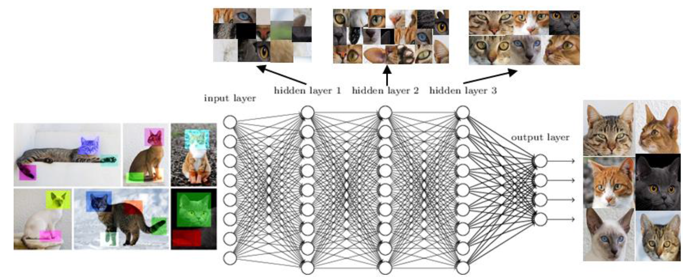
Basic functionality of AI systems
Core principle: from input to output
Machine Learning (ML)
Data analysis/modeling
Complex statistics
Computing of probabilities
Input
Output
Example of
Deep Learning
Image: Strauß, S. (2018). From Big Data to Deep Learning: A Leap Towards Strong AI or ‘Intelligentia Obscura’? Big Data and Cognitive Computing, 2(3), 16. https://doi.org/10.3390/bdcc2030016, p. 6)

Slide 6
Basic functionality of AI systems
AI is useful for:
information
data modeling & pattern recognition
generating & transforming different contents (e.g. production/transformation of text, images, audio/video) etc.
mapping of existing knowledge
BUT:
Quality of data & input has impact on quality of output & results
and thus on the functionality and usefuleness of an AI-system as a whole

Slide 7

Flash discussion: Can frogs become cats?
Approach:
Discuss in 2 min.
What would happen in this example,
if images of frogs are in the input data?
Image: Strauß, S. (2018). From Big Data to Deep Learning: A Leap Towards Strong AI or ‘Intelligentia Obscura’? Big Data and Cognitive Computing, 2(3), 16. https://doi.org/10.3390/bdcc2030016, p. 6)

Slide 8
Overview of basic types of machine Learning

Slide 9
Overview of basic types of machine learning
Supervised learning
Predefined „learning“-aim &
data structure
works with small amounts of data but effort of pre-labeling
results are verifiable
Examples: spam filtering; image classification
unsupervised learning
no predefined „learning“ aims & unstructured data
Useful to organise large data sets & find patterns or anomalies
Imprecise; difficult to verify results
Examples: medica/genetic data analysis; weather forecasts
Reinforcement learning
Known aim, agent tries to optimize output based on trial-&-error
gathers unstructured (sensor) data from its environment
imprecise, unstable, costly regarding data and computing power
Examples: robotics; chatbots
Deep learning
most complex unsupervised ML type, imitates neuronal networks, large amounts of unstructured data
Highly dynamic, resource intensive unpredictable & opaque behavior
Examples: LLMs; image/audio recognition; physical data analysis

Slide 10
Summary of basic types of ML
Different degrees of automation for each ML type
In practice: mostly a combination of different ML types (e.g. DL+RL)
Type of ML approach has high impact on quality of output
Each ML type has pros & cons – not every type is suitable for every task

Slide 11
Single work + group discussion
Approach:
Time 15 min.
Handout: 4 cards with ML types (see prev. Slide)
1 list of 4-6 AI applications
(e.g. chatbots, speech recognition, image or object recognition, robotics, medical data analysis, self-driving cars)
Each group selects 2 example applications
Do a little online research:
  Think of an AI-application (or select from pre-defined list) and try to find out, what ML approach it uses. Example: „reinforcement learning in robotics“
Discuss advantages & disadvantages of the ML type based on your example application
Then share your findings with the whole group (flipchart)
If you had troubles, discuss what difficulities you encountered to do the task.
machine learning types

Slide 12
Important peculiarities of AI

Slide 13
Important peculiarities of AI-based technology
Classical automation technology …
… is mostly rule-based = the functionality of a technical system is based on predetermined rules that do not suddenly change.
This makes the technology predictable in its behavior
Examples: manufacturing machine, heating system
AI technology …
… works differently and is more dynamic and complex: it can dynamically change its behavior.
This makes AI technology less predictable and less controllable
Examples: Large-language-models (LLM-)based chatbots, self-driving cars

Slide 14
Important peculiarities of AI-based technology
AI technology is VUCA – volatile, uncertain, complex & ambiguous:
Volatility:
AI can behave unpredictably & produce unstable, erratic results
Uncertainty:
AI is not reliable; its functionality is a „black box“
→ it is unclear how AI operates and produces results
Complexity:
The high complexity of AI systems can increase process complexity
Ambiguity:
AI systems can dynamically change their functionality;
output can be obscure, with varying quality and meanings

Slide 15

AI is like a stochastic parrot
Remember: I am just a parrot and reproduce content that already exists somewhere.
I really don‘t know or understand anything at all!
Approach:
Discuss in 2 min.
What does it mean when AI generates output based on probabilities?
Why is it important to comprehend that?
How is my driving?
AI is a computing machine that imitates human capabilities
Every ML type is based on highly complex mathematical & statistical computing
E.g. speech-based AI systems like LLMs and chatbots calculate word probabilities
AI only reproduces language but is not capable of understanding its meaning
Therefore: Critical reflexion of AI-generated output is always essential

Slide 16
The ELIZA effect and automation bias

Slide 17
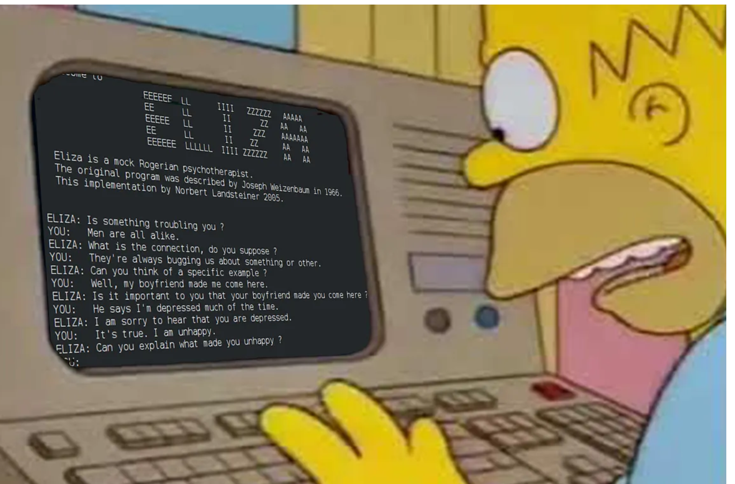
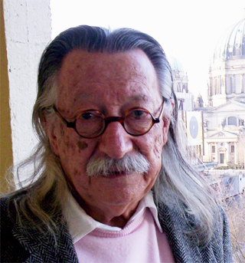
The ELIZA Effect
  Homer Simpson being convinced of an AI Chatbot‘s sentiency
In 1966, Joseph Weizenbaum developed „ELIZA“, the very first chatbot
Aim: to explore human-machine communication and point out the according limits of computer systems
ELIZA became a showcase for the pitfalls of AI technology
Approach:
Discuss in 1 min.
Have you ever heard of the so-called „Eliza effect“?
Image: https://medium.com/@jemimamaybank/the-eliza-effect-how-ai-chatbots-get-into-our-heads-9e3970f8fa06
„I had not realized […] that extremely short exposures to a relatively simple computer program could induce powerful delusional thinking in quite normal people.”
(Weizenbaum, Joseph (1976). Computer Power and Human Reason: From Judgement to Calculation. W. H. Freeman. p. 7)
Image: https://en.wikipedia.org/wiki/Joseph_Weizenbaum under CC BY-SA 3.0
The tendency of persons to „humanize“, i.e., project human traits (e.g. knowing, understanding, feeling etc.) into text-based computer systems
is known as „ELIZA effect“
It is related to a further issue …

Slide 18
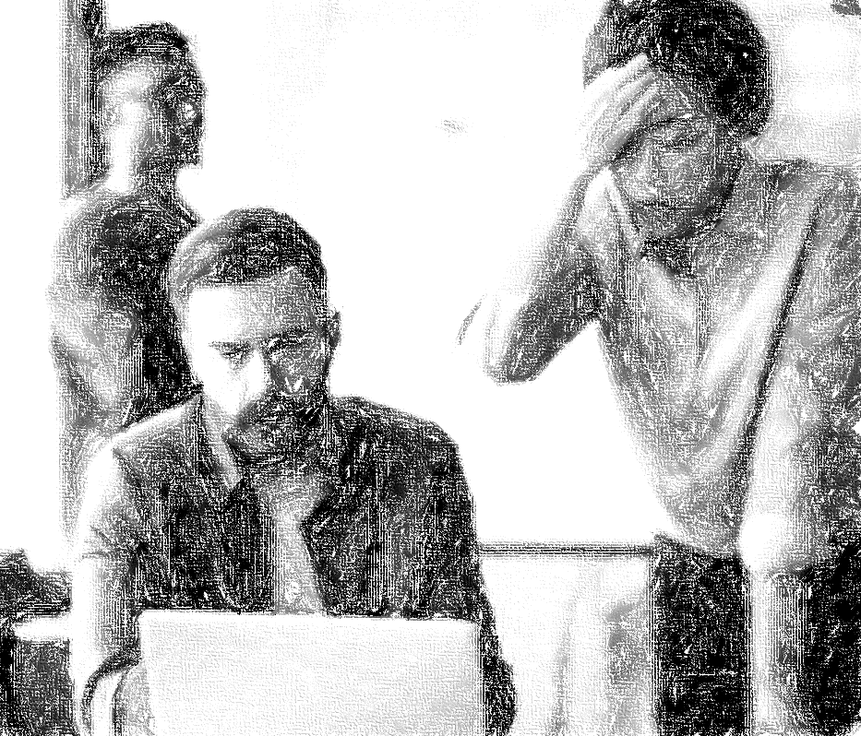
(Deep) automation bias and overreliance in AI
Mismatch between system behaviour and user practice
Automation bias
human propensity to blindly trust technology + uncritically accept its outcome
→ Wrong expectations of functionality & limits of automation technology
AI technology
… can reinforce and deepen the risk of automation bias, because it is more complex, dynamic & unpredictable in its behavior (Strauß 2018/2021)
eh.. because AI said so…?
OMG WHY?!!!
Image: AI-generated with craiyon.com

Slide 19
Vicious cycle
unpredictable AI system behavior
Pressure to (re-)act
lacking correctability
Blind trust
Wrong decisions

Slide 20


Human vs. Machine?
A practical example of automation bias
Autonomy …
… is simply put the ability to act freely and make one‘s own decisions based on self-defined rules
AI …
… can automate certain tasks to improve human agency and autonomy
But what happens in case of conflicts between human & AI decisions?
Every AI is a machine
It has no real autonomy but only computes probabilities
Turn to the right
➔ Core risk: Loss of human autonomy and agency to AI

Slide 21
Group discussion
Approach:
Time 20-25 min.
Potential Questions:
Why is important to avoid overreliance & blind trust in AI-technology?
Is the ELIZA effect still relevant today?
What is the connection between the Eliza effect and automation bias?
Why can modern AI technologies reinforce these risks?
What is the impact of these risks? What can be problematic effects?
How can these risks be avoided? What would that require?
Discuss this in small groups (4-5 persons) and think of practical examples.
Then share your findings with others (e.g. on flipchart)
Reflecting on risks of AI
Optional: Watch a short video describing the ELIZA effect and then discuss its impact.

Slide 22


Thank you for your interest and attention.
Funded by the European Union. Views and opinions expressed are however those of the author(s) only and do not necessarily reflect those of the European Union or the European Education and Culture Executive Agency (EACEA). Neither the European Union nor EACEA can be held responsible for them.
Project No: KA220-VET-000165375
Copyright © 2026 by the partner consortium of the project “AI.D – Artificial Intelligence and the Shaping of Democracy”
This work is licensed under CC BY-SA 4.0

