Slide 1








Origins, Definitions and Meaning of AI
Module 1 – Not Everything is AI: What is AI and what is not?
Teaching Unit 1 – What is AI?

Slide 2

Content
What is AI? Overview on origins, definitions and meaning
How AI involves imitation and deception (Turing Test)
Reflecting on common narratives and claims of AI
3.1 Group discussion
What is the impact of AI?
4.1 Single and group work discussion of advantages and risks
Summary and lessons learned

Slide 3
What is AI?

Slide 4
Flash discussion
How would you describe AI?
What AI-tools do you know or already use?
Approach:
Warm-up: Discuss in 1-2 min.

Slide 5
What is Artificial Intelligence (AI)?
– origins, definitions and meaning
AI has a long history of more than 70 years
Classical concepts:
AI = "the science and engineering of
making intelligent machines“ (McCarthy 1955)
“study of mental faculties through the use of computational models” (McDermott 1985/Fogel 2005)
“understanding the nature of intelligent thought” (Buchanan 2005)
Modern:
sub-discipline of computer science (informatics)
aiming at imitating & supporting human skills
(e.g., logical reasoning, learning, planning etc.)
The term AI as such is simply a buzzword
AI = use of math &-statistical methods “Learning”-Algorithms (Machine Learning = ML)

Slide 6
What is Artificial Intelligence (AI)?
– origins, definitions and meaning
EU-definition:
machine-based system, designed to operate with varying levels of autonomy that may exhibit adaptiveness after deployment and that, for explicit or implicit objectives, infers, from the input it receives, how to generate outputs such as predictions, content, recommendations, or decisions that can influence physical
or virtual environments. (Art. 3 (1) EU AI Act)
Put simply:
AI is used as umbrella term for novel automation technologies
AI = automated system to support workflows & decision-making procedures generating results of varying quality

Slide 7
How AI involves imitation and deception (Turing Test)

Slide 8
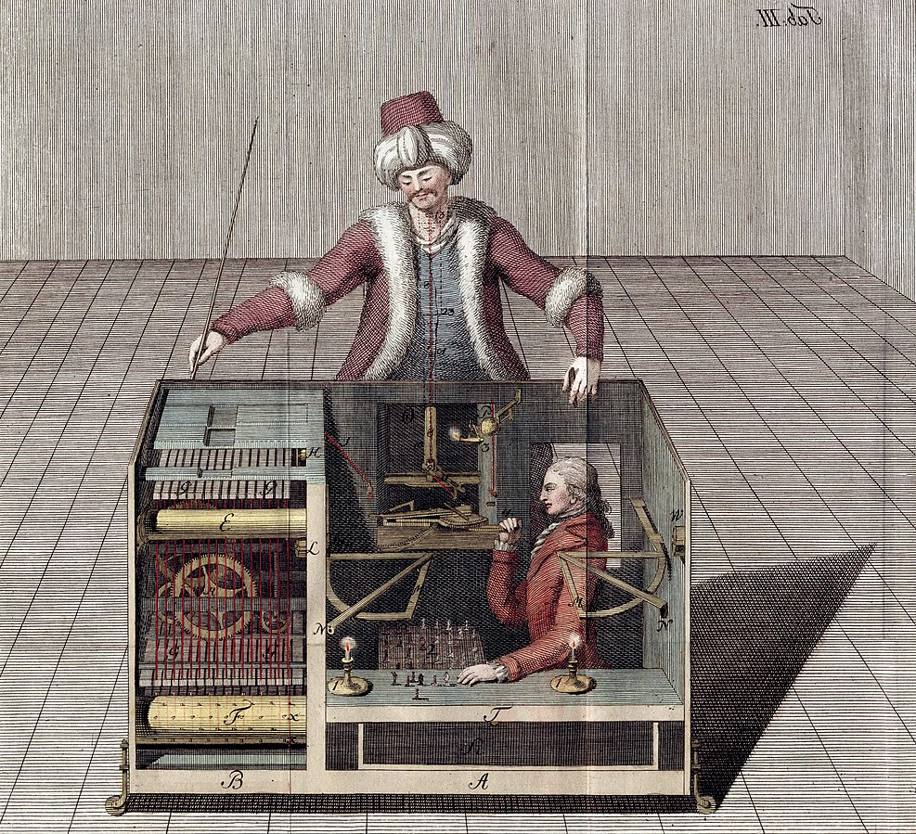
Flash discussion
Approach:
Discuss in 1-2 min.
What do you see on that image?
How does this image relate to AI?
Mechanical chess player, 1789
The image shows a deceiving construction with a hidden person pretending to be a machine playing chess. The player does not see the other person.
This has nothing to do with AI.
But deception might play an important role …
Image: https://en.wikipedia.org/wiki/Mechanical_Turk

Slide 9
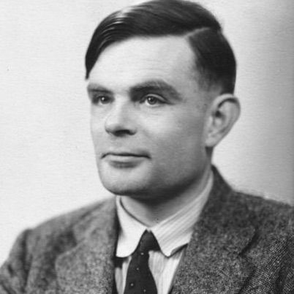
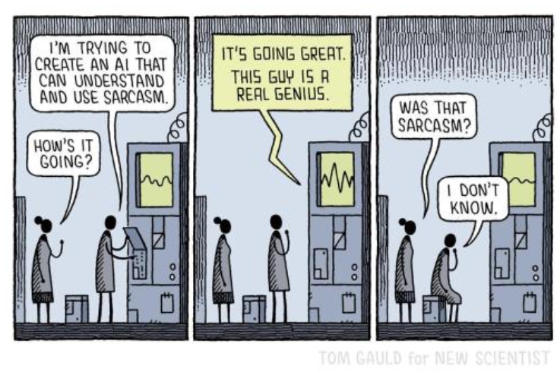
The Turing-Test or the „Turing-Misconception“
“The original question, ‘Can machines think?' I believe to be too meaningless to deserve discussion.”
(Turing, 1950)
The Turing Test is often misunderstood as „intelligence test“ of AI
In fact the original concept was called: “The Imitation Game”
- Can machines be successful in deceiving humans?
The test succeeds, if a person does not recognize to interact with a machine
Today, the test is less important but the example highlights how wrong assumptions of AI can complicate understanding the technology
Approach:
Discussion in 1 min.
Have you heard of the Turing Test?
What is being tested here?
Image: https://en.wikipedia.org/wiki/Alan_Turing
Image: Tom Gauld for New Scientist (https://www.newscientist.com/article/0-tom-gaulds-attempts-to-create-a-sarcastic-ai-are-really-genius/)

Slide 10
Reflecting on common narratives and claims of AI

Slide 11
Common Narratives on Artificial Intelligence
Questionable meta-narrative on both sides:
AI is superior to humans (?!) …
AI …
Friendly Wizard scenario
Terminator scenario
… boosts efficiency & productivity
… competitive advantages & innovation
… improves customer relationships
… makes no mistakes and is reliable
… raises quality & saves ressources
… eases workload, enables room for creativity & improves working conditions
…
… threatens jobs
… reinforces discrimination
… threatens privacy
… is a security nightmare
… curtails freedom & autonomy
… aggravates worker exploitation &
leads to dehuminization
…
Vs.
Misleading narratives & assumptions on AI as superior technology
create high expectations, fears and boost polarization in public discourse
hamper realistic views on and informed use of AI-based technologies

Slide 12
Group discussion
Approach:
Discussion 10 – 15 min.
Potential Questions:
How realistic and plausible are those narratives?
Are there practical examples that underpin them
or are they unproven claims?
What is the difference between narratives and effects in practice?
Why is it important to question narratives and claims?
What could be the rationale behind these narratives?
Reflecting on common narratives and claims on AI

Slide 13
What is the impact of AI?

Slide 14
Potential impact of AI in almost all societal domains
AI …
is a digital technology with a long history
often used as synonym for new automation technologies
is an integral part of the digital transformation of society
affects how technology is embedded in working environments,
economic, social & political practices
Media & public sphere
Science & research
Labour & economy
Politics & governments
Culture & social life
Individuals
Digital technologies/ICTs
Datafication
Big Data
Algorithms
AI/Machine Learning
Figure 1: own illustration

Slide 15
Single work + group discussion
Approach:
Time 15 – 20 min.
Single work:
Identify 3 advantages and 3 risks of AI
and relate them to practical examples.
Group work:
Share your findings and discuss them in the group.
Discuss: What is the impact of AI on society?
What are main challenges to reduce the risks of AI?
Impact of AI

Slide 16
Summary and lessons learned

Slide 17
Reality check: differentiate AI usage between prospect and reality
AI provides new options for …
  production of information and digital content
  Process optimization, data modelling, -visualization & -analysis etc.
Assistance at work and automation of repetitive tasks
Supportive for developing ideas and decisions
➔ AI/ML can contribute to manage complexity
➔ But AI-usage also leads to more complexity
Lacking transparency, reliability & , increasing proneness to errors
Increasing dependency to AI-systems & critical impact of errors
Additional effort & costs for deployment & maintenance of AI-systems
(Data management, quality assurance etc.)

Slide 18
Perceive AI as tool (e.g. to facilitate creativity, productivity)
that is supportive for particular tasks, requiring some new skills
but not as universal problem-solving machine to ease all work
Conclusion

Slide 19


Thank you for your interest and attention.
Funded by the European Union. Views and opinions expressed are however those of the author(s) only and do not necessarily reflect those of the European Union or the European Education and Culture Executive Agency (EACEA). Neither the European Union nor EACEA can be held responsible for them.
Project No: KA220-VET-000165375
Copyright © 2026 by the partner consortium of the project “AI.D – Artificial Intelligence and the Shaping of Democracy”
This work is licensed under CC BY-SA 4.0

